Slide 1

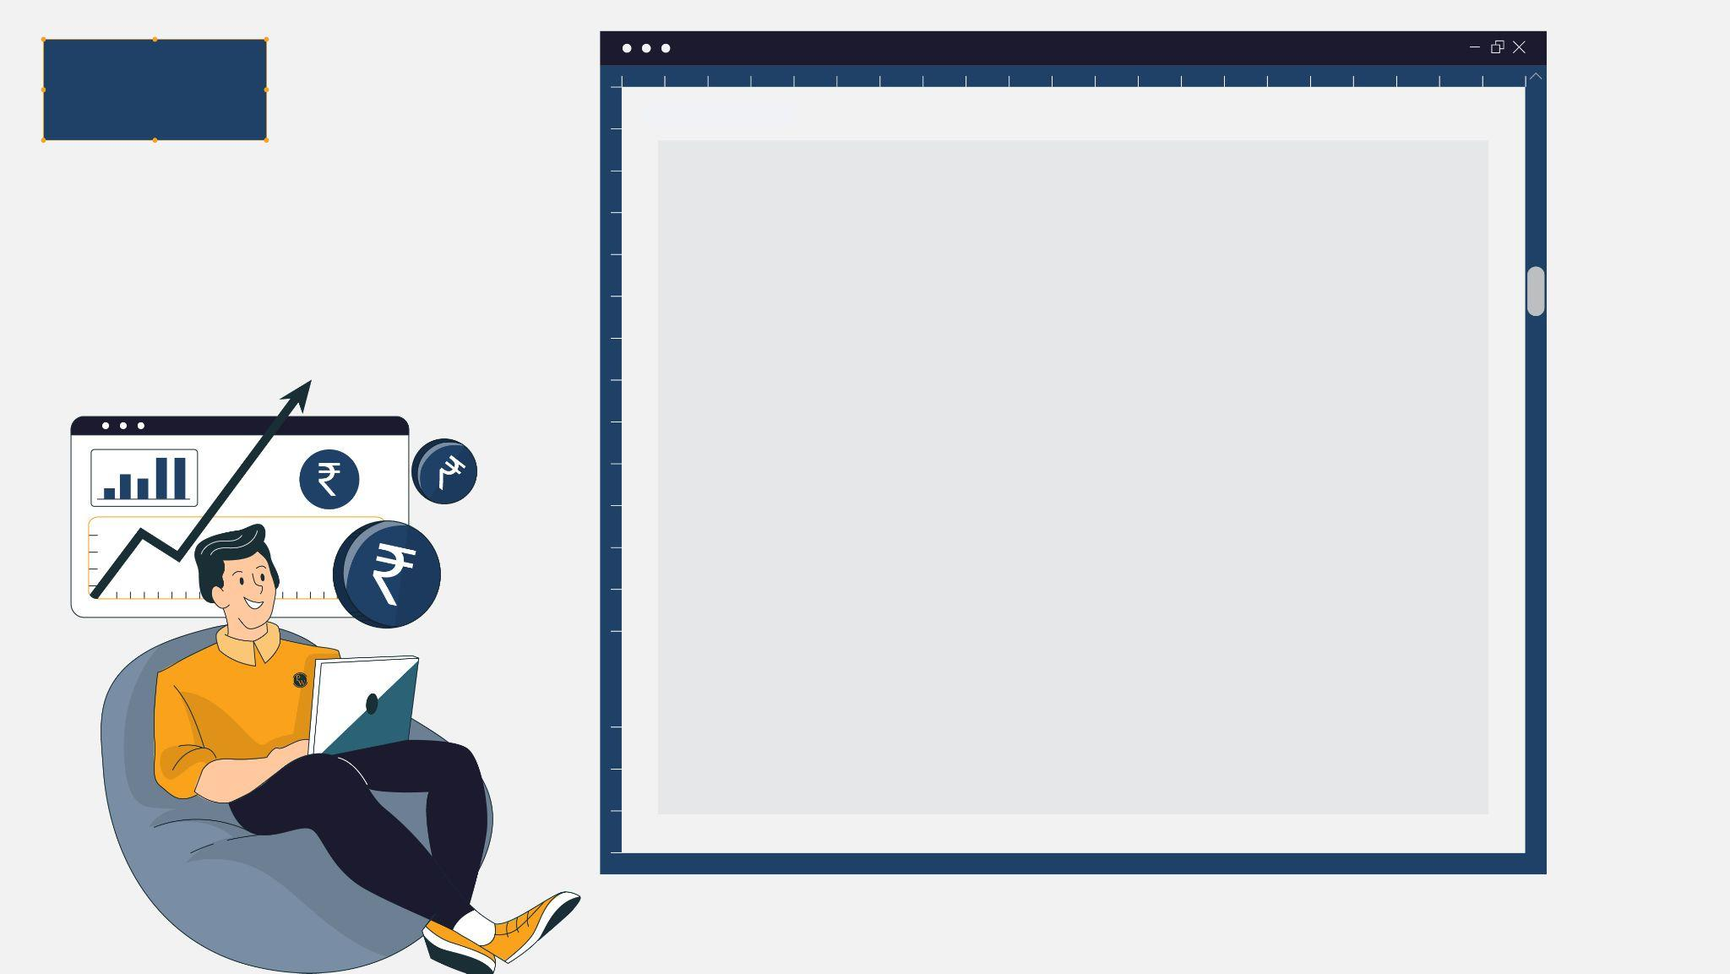
FINANCE
STOCK MARKET
DATA
Stock Market - Timings and Basic Terminologies - I
BANKING
MARKETING

Slide 2
Market Timings
S. No. | Name | Timing | Remarks
1. | Pre-opening Session | 9:00 am – 9:08 am | Orders can be placed for any transaction in this period.
 |  | 9:08 am - 9:15 am | 9:08 am – 9:12 am: Price determination of a share takes place via price matching order to determine prices at which trading will begin. 9:12 am – 9:15 am: Transition period between pre opening session and normal market hours
2. | Market Hours or Normal Session | 9:15 am – 3:30 pm | Normal trading hours. Transactions are executed via bilateral order matching system. Price is determined through demand and supply forces
3. | Post-closing session | 3:30 pm – 4:00 pm | 3:30 pm – 3:40 pm: Closing price is calculated using a weighted average of prices at securities trading from 3 pm – 3.30 pm in a stock exchange. 3:40 pm – 4:00 pm: Bids for the following day’s trade can be placed.
4. | After Market Hours |  | No transactions can take place. Investors can place aftermarket orders, which are executed the next day.

Slide 3
Is it compulsory to purchase/sell the shares at current market price?
It is not compulsory to purchase or sell shares at the current market price
Limit order allows to specify the price at which you are willing to buy/sell the share
If the current market price of a stock is Rs. 200, you can place a buy limit order at Rs. 195, which means that you are willing to buy the shares only if the price falls to Rs. 195 or below. Similarly, you can place a sell limit order
If the market price of the share does not reach the specified limit price, the order may not get executed.

Slide 4
Price of a stock
Opening Price - price at which a security first trades when an exchange opens and may be different from previous day’s closing price.
Gap Up - occurs when the opening price of the stock is higher than the previous day’s high price
Gap Down - occurs when the opening price of the stock is lower than the previous day's low price
Gaps appear when there is sharp rise/fall in price of the stock when no trading activity is being carried out.
Gaps could be created because of any positive/negative factors like increase in earnings of the company, change in traders view, etc.

Slide 5
Price of a stock
Closing Price - calculated using a weighted average of prices a share trading from 3 pm – 3.30 pm
Day’s High - highest price at which the security has traded during a trading day
Day’s Low - lowest price at which the security has traded during a trading day
OHLC stands for Open-High-Low-Close Price.
Last Traded Price - it is the price at the the latest or the most recent trade occurred.
The Last Traded Price of a stock at 3:30 pm is not same as Closing Price because closing price is calculated using a weighted average of prices a share trading from 3 pm – 3.30 pm in an exchange.
52 week high/low – these represent the highest/lowest price at which a stock has traded during the immediate previous 52 weeks.

Slide 6
Market Capitalization
Market Capitalization of a share is the total value of all the shares of a company, i.e. , price per share multiplied by the number of outstanding shares
For example, HCL has 2,71,36,65,096 outstanding shares. As on Jan 20, 2023, the price of an HCL share is Rs. 1,107.75
Therefore, market capitalization of HCL is Rs. 3,00,606 Crore. (Rs. 1,107.75 per share* 2,71,36,65,096 shares)
Free float, also known as public float, refers to the number of shares of a company that are available to the public for trading in the secondary market
This is the difference between total number of shares and any restricted shares(shares that are not transferable or shares held for promoter group)

Slide 7
Market Capitalization
Free float market capitalization is the total value of free float shares of a company i.e., Free float multiplied by price per share.
The free float of HCL as on Jan 20, 2023, is Rs. 1,17,236 Crore (around 61% of shares are held by Promoter and employees, thus not forming part of free float)
The Market Capitalization of a stock may be different from true valuation.
Valuation refers to intrinsic/true value of a stock based on its cash generating potential.
This may not always be reflected in the prevalent stock price at the time which leads to a difference in market capitalization and valuation.

Slide 8
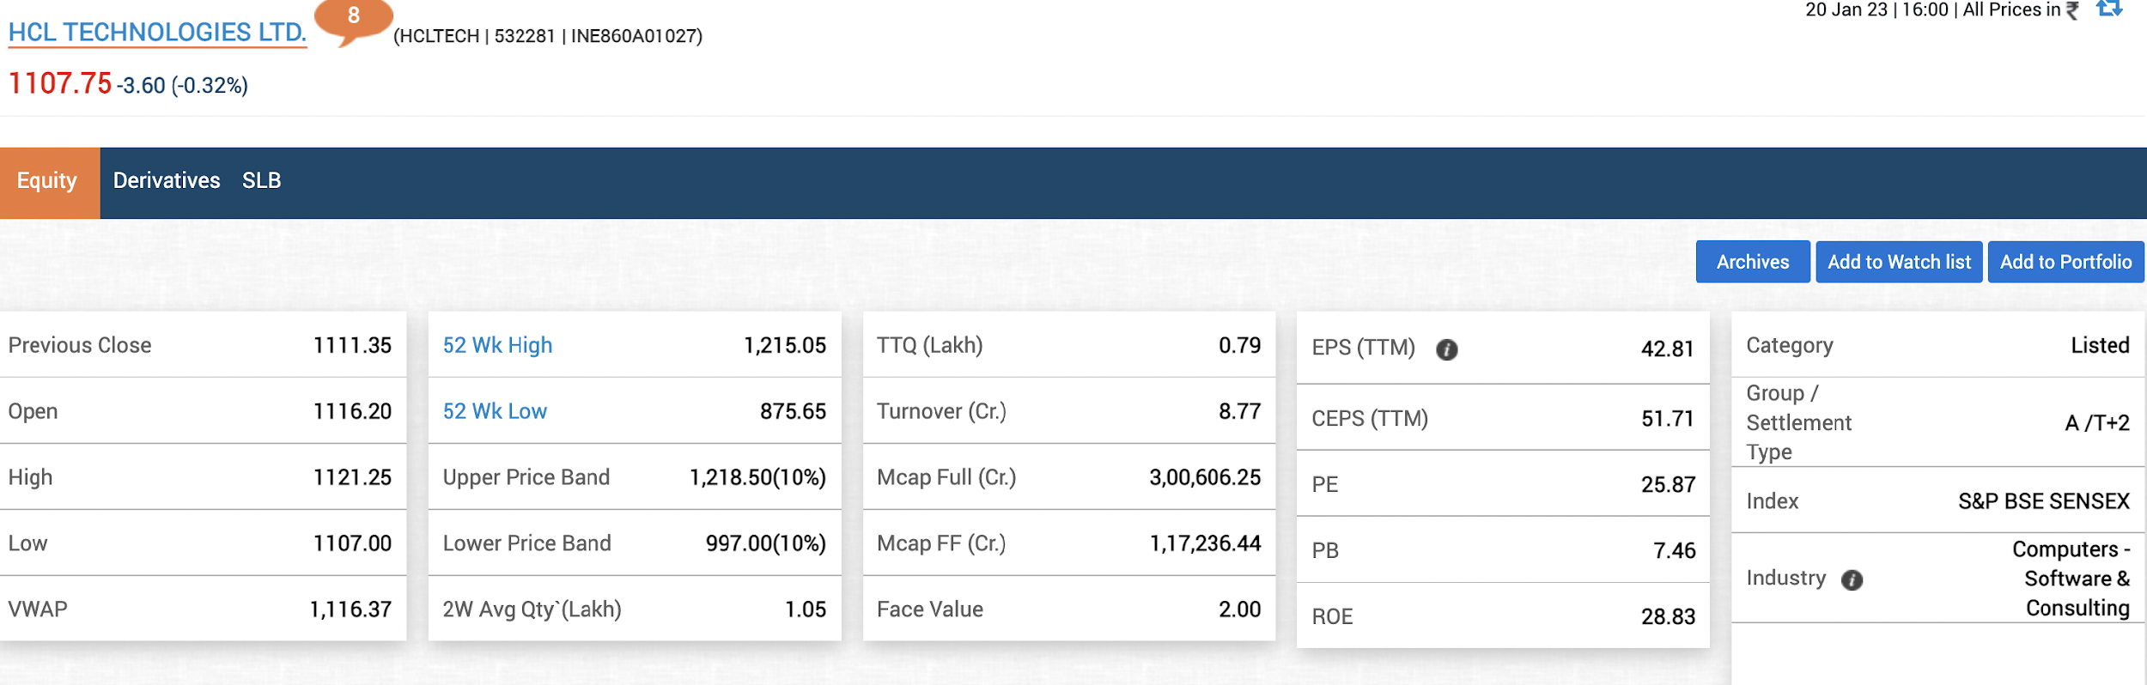
Market Capitalization
Snapshot from BSE’s website reflecting various terms for HCL Technologies Limited

Slide 9
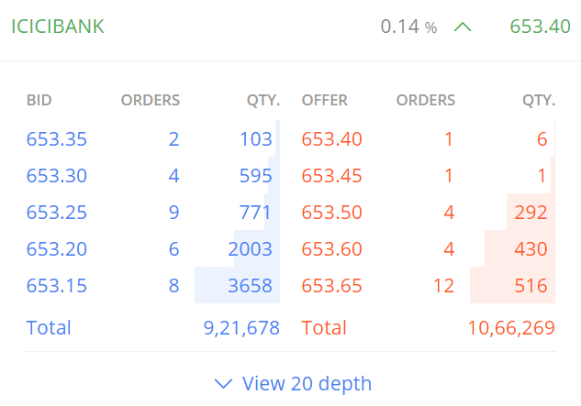
Bid and Offer Price
Here is an example of what a real-time demand-supply scenario for a stock (ICICI Bank) looks like:
The text in blue reflects buyers and text is red reflects sellers.
Bid price is the highest price a buyer is willing to pay and is almost always lower than the offer price.
Bid quantity is the number of shares an investor is willing to buy at the bid price.

Slide 10
Bid and Offer Price
Offer price refers to the lowest price a seller will accept to sell shares at any given time.
Offer quantity is the number of shares an investor is willing to sell at the offer price.
In the above example, 2 buyers to willing to buy 103 shares of ICICI Bank at a price of Rs. 653.35/share and 1 seller is willing to 6 shares of ICICI Bank at Rs. 653.40/share.

Slide 11
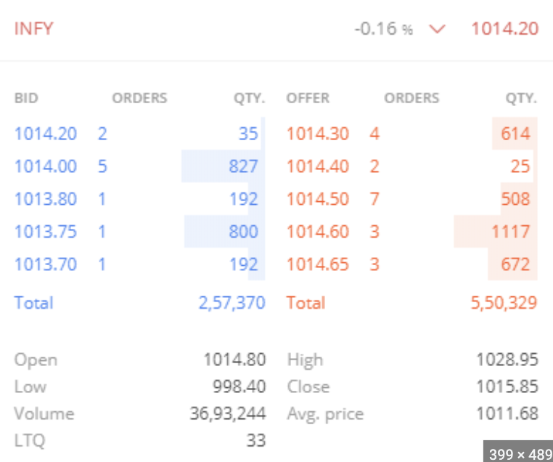
Share Volume
Share Volume means the total number of shares traded in a specified time period
Higher trading volumes means the stock is more liquid. It also signifies higher interest of investors in the stock.
Share volume is used to confirm a trend's existence or trend reversal in the price of a stock. Any price action in a stock with high volumes is seen as a signal to enter or exit a stock.

Slide 12
Share Volume
When a stock is bought and sold on the same day, it is described as an intraday trade
However, the stock is not sold on the day of buying, it is referred to as taking delivery of the stock
Delivery Volume is the difference between total volume of a share and shares traded on an intraday basis
It is very important indicator to show whether the stock is bought for long term or for speculative trading
A high delivery volume signifies that there is long-term interest in the share and is not being traded for speculative purposes.
It could also signify a buying opportunity because as a beginner in the stock markets you may not want to hold stocks that have a low delivery volume.

Slide 13
FINANCE
STOCK MARKET
DATA
THANK
YOU
BANKING
MARKETING

